Slide 1
POISSON REGRESSION

Slide 2
Contents
Understanding Poisson Distribution
Poisson Regression – Concept and Applications
Statistical Model
Case Study
Model Fitting in R
Measure of Goodness of Fit and Predictions
Zero-Inflated Poisson Regression
Offset Variable in Poisson Regression

Slide 3
Understanding Poisson Distribution
Suppose we wish to study the number of accidents taking place on a busy highway in a year. Number of accidents is a count variable and the event ‘accident’ is considered as rare event
There are several phenomena where variable is a ‘count’ and is observed in a specific time period; such as,
Number of deaths caused by lightening in six months
Number of visits to a dentist per year
Such random variables do not follow Normal distribution and hence cannot be modeled using multiple linear regression
The probability distribution best suited for such data is Poisson distribution and the regression model is Poisson regression
*
The distribution is named after French mathematician Siméon Denis Poisson

Slide 4

Understanding Poisson Distribution
Poisson distribution is a limiting case of Binomial distribution where
n (Number of trials) is very large ( n →∞ ) and
p (Probability of success) is very small ( p →0 ) such that
np is finite ( say λ )
In other words, chance of a success is very small and trial is repeated large number of times
The Probability Mass Function is :
Poisson distribution is specified with a single parameter λ .
For Poisson distribution Mean = Variance = λ

Slide 5
Poisson Regression
DEPENDENT VARIABLE
INDEPENDENT VARIABLE
Count
Often it is the count of the rare event. Counts are all positive integers
Categorical or Continuous
Poisson regression is most suitable in the case of rare events
Poisson regression is a type of Generalised Linear Model, where the link function is a logarithm and the underlying distribution is Poisson

Slide 6
Application Areas
Industry/Function
Model/Predict
Based on Information such as:
Purpose
Insurance Analytics
Insurance Claims
Details of the Policy Holder, Characteristics of the Risk
Prediction
Education or HR
Absenteeism
Demographics of Student/Employee, Features of the Institute/Company
Prediction / Optimisation
Clinical Research
Adverse Events During a Clinical Trial
Dosage of the Medicine, Patient History, External Conditions, Patient Demographics
Prediction

Slide 7
Statistical Model
log(λ)= b₀ + b₁x₁ + b₂x₂ + ….. + b_{k}x_{k}
Where, λ is the conditional mean of Y given X
Here ordinary least square method used in multiple linear regression is not appropriate as Y is discrete and RHS is continuous
log(λ) is the link function used in Poisson Regression which establishes link between 'Y' and linear combination of X's
Note that λ is greater than zero and its log will be negative if it lies between 0 and 1
The regression coefficients are estimated using the method of maximum likelihood

Slide 8
Case Study – Modeling Number of Complaints
Background
Objective
Available Information
A company has recently launched a loyalty program under which they collected information about their customers. The next leg of the program aims to add 20,000 customers to their loyalty pool. The company wants to understand if the number of complaints by a customer can be modeled in order to set up a call centre with optimum strength.
To model number of complaints to prepare a road map for the call centre in the next leg of loyalty program
Information is available about Region, Loyalty Tier, Complaints and Customer’s Association with the Company
Sample size is 113

Slide 9
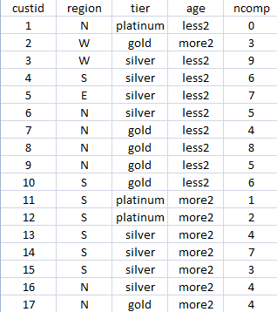
Data Snapshot
Complaints
Independent variables
Dependent variable
Columns | Description | Type | Measurement | Possible values
custid | Customer ID | character | - | -
region | Region to which the customer belongs | categorical | E,W,N,S | 4
tier | Loyalty program tier of the customer | categorical | platinum, gold, silver | 3
age | Representing customer’s association with the company | categorical | less2, more2 | 2
ncomp | Number of complaints | Integer(count) | - | positive values
observations

Slide 10
Model for the Case Study
All independent variables (region, tier and age) in the case study are categorical
Independent variables | Categories | Base category
region | East(E), West(W), North(N), South(S) | East(E)
tier | platinum, gold, silver | gold
age | less2, more2 | less2

Slide 11

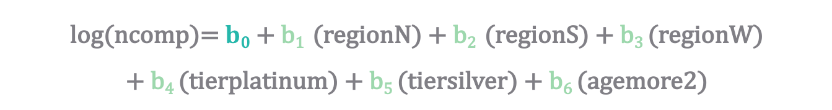
Model for the Case Study
The Poisson regression model is :
Intercept
Independent Variables
Log($λ$)
log(ncomp)= $b$₀ + b₁ (regionN) + b₂ (regionS) + b₃ (regionW)
+ b₄ (tierplatinum) + b₅ (tiersilver) + b₆ (agemore2)
Parameter Estimates

Slide 12
Model Fitting in R
#Importing the Data
calldata<-read.csv("Complaints.csv",header=TRUE)
#Model Fitting
compmodel<-glm(formula=ncomp~region+tier+age,data=calldata, family='poisson') summary(compmodel)
glm() fits a generalised linear model.
family=poisson ensures that a Poisson regression is used.
summary() yields model summary.

Slide 13
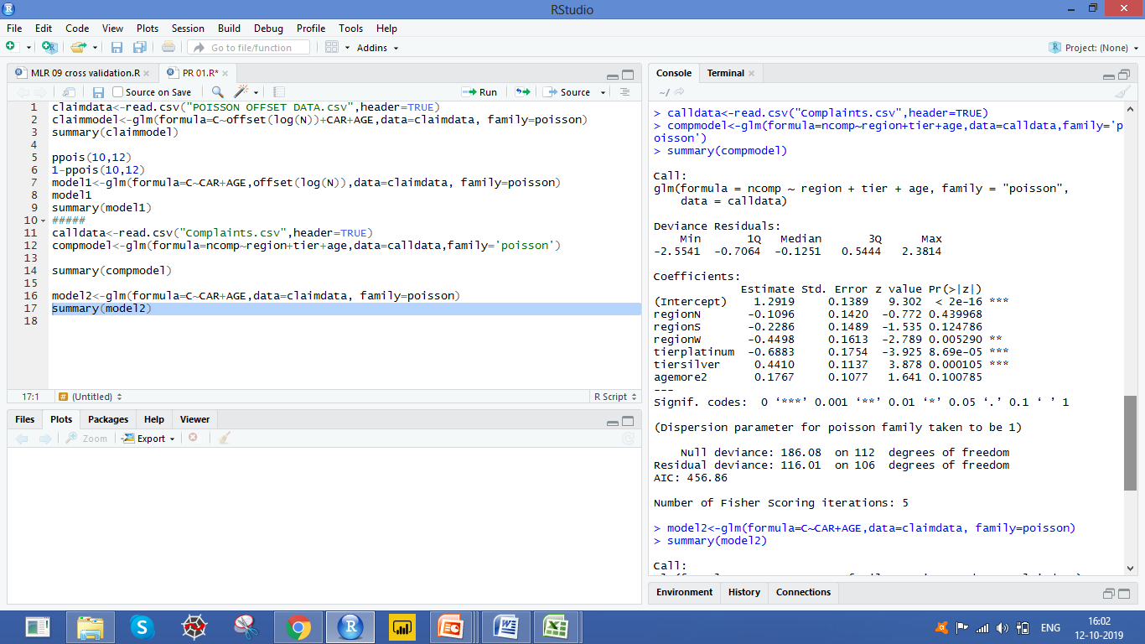
Model Fitting in R
# Output
Interpretation:
The Estimate column gives the estimates of coefficients of the independent variables in the model.

Slide 14
Individual Testing in R
# Identifying significant variables
summary(compmodel)
# Output
Interpretation:
The p-values for regionW, tierplatinum, tiersilver are <0.05
regionW is significant, with a negative coefficient : likelihood of complaints coming from West region is lower compared to complaints from East region
tierplatinum and tiersilver are significant, with a negative and positive coefficients respectively : compared to the base tier Gold, customers from Silver category tend to complain more whereas complaints from Platinum customers are the least

Slide 15


Goodness of Fit
Objective | To test the null hypothesis that the model is a good fit
Null Hypothesis (H₀): Model is a good fit
Alternate Hypothesis (H₁): There is significant lack of fit
Test Statistic
Decision Criteria | Reject the null hypothesis if p-value < 0.05
or

Slide 16
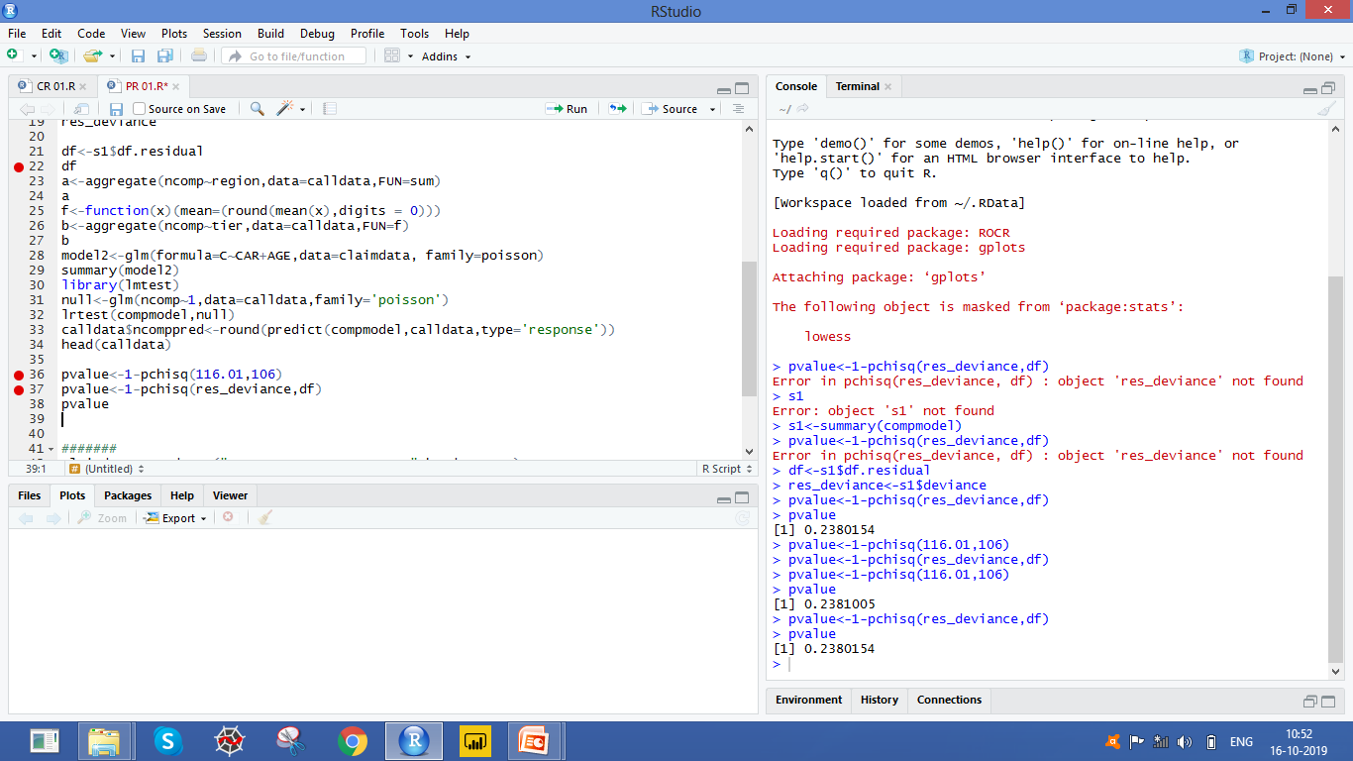
Goodness of fit in R
#Goodness of Fit
s1<-summary(compmodel) res_deviance<-s1$deviance df<-s1$df.residual pvalue<-1-pchisq(res_deviance,df) pvalue
creating an object s1 to store summary of compmodel
storing residual deviance in res_deviance
storing the corresponding degrees of freedom in df
pchisq() calculates Chi-square value by using (Residual,
degrees of freedom) as the arguments
# Output
Interpretation:
p-value > 0.05, Do not reject H₀.
The model can be considered to be a good fit .

Slide 17
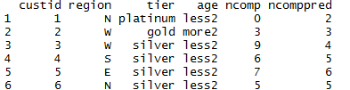
Predictions in R
#Predictions
calldata$ncomppred<-round(predict(compmodel,calldata,type='response')) head(calldata)
predict() requires model object, data and type.
type=‘response’ gives the predicted probabilities
# Output
Interpretation:
The last two columns are observed and predicted vales of “ncomp”

Slide 18
Introduction to Zero-Inflated Poisson Regression
One common cause of over-dispersion is excess zeros, which in turn are generated by an additional data generating process. In this situation, zero-inflated poisson regression should be considered
Zero-inflated models attempt to account for excess zeros. In other words, two kinds of zeros are thought to exist in the data, "true zeros" and "excess zeros". Zero-inflated models estimate two equations simultaneously, one for the count model and one for the excess zeros.
# Zero-Inflated Poisson Regression
install.packages("pscl") library(pscl) zip_model<-zeroinfl(formula= dependent variable~ independent variables| variable causing zero inflation, data= data) summary(zip_model)

Slide 19
Offset Variable in Poisson Regression
Poisson regression can be used to analyze not only the count data but also the rate data
Rates are simply counts divided by a measure like total count or time. For ex. Insurance claim rate is measured as number of claims divided by the total number of the policy-holders (say N)
The log transformed regression variable with the constant coefficient of 1 for each observation is known as ‘Offset’
The Poisson model is fit to the counts & uses the log of the denominator (usually N) as an offset variable
Model in R using offset variable ( C is number of claims, CAR is vehicle type ,AGE is vehicle age and N is number of policies)
claimmodel<-glm(formula=C~offset(log(N))+CAR+AGE,data=claimdata,
family=poisson)

Slide 20
Quick Recap
In this session, we learnt the basics of Poisson regression.
Poisson Regression
Is used to model count of a rare event
Model Building
glm function is used to perform Poisson Regression
Family=“poisson” is used inside glm function
Parameter estimation
Parameters are estimated by maximum likelihood estimation method
Check Variable Significance
Hypothesis Testing

Slide 21
Quick Recap
Measure Goodness of Fit and Predictions
Check Residual Deviance and Degrees of Freedom as a measure of goodness of fit
Deviance follows a chi-squared distribution, with degrees of freedom equal to the difference in the number of parameters
Predict the count using the estimated model parameters
Zero-Inflated Poisson Regression
Is used when there are excess zeros in the count which are generated by an additional data generating process

Slide 22
THANK YOU!!

